Slide 1
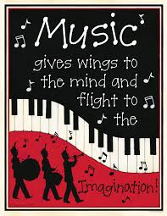
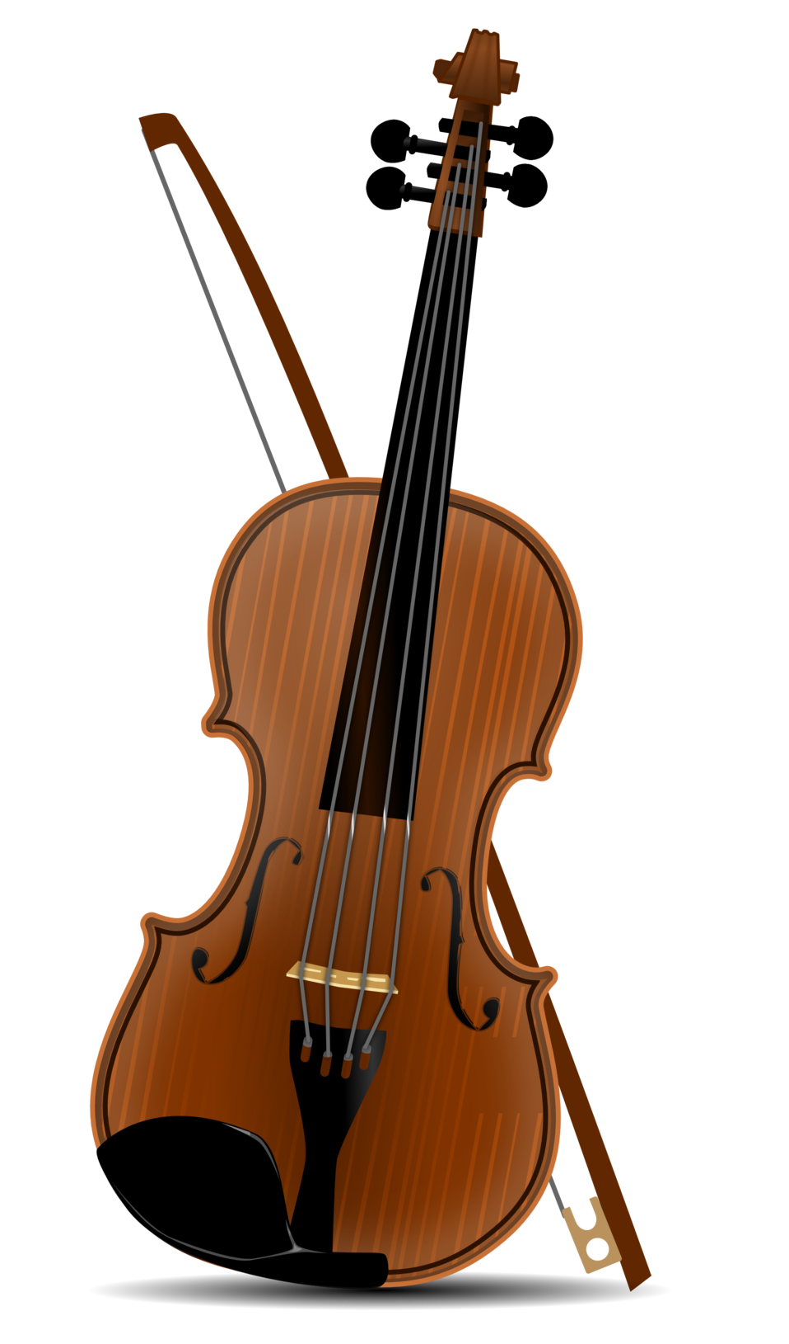
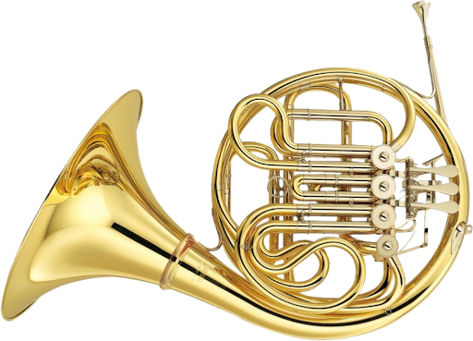
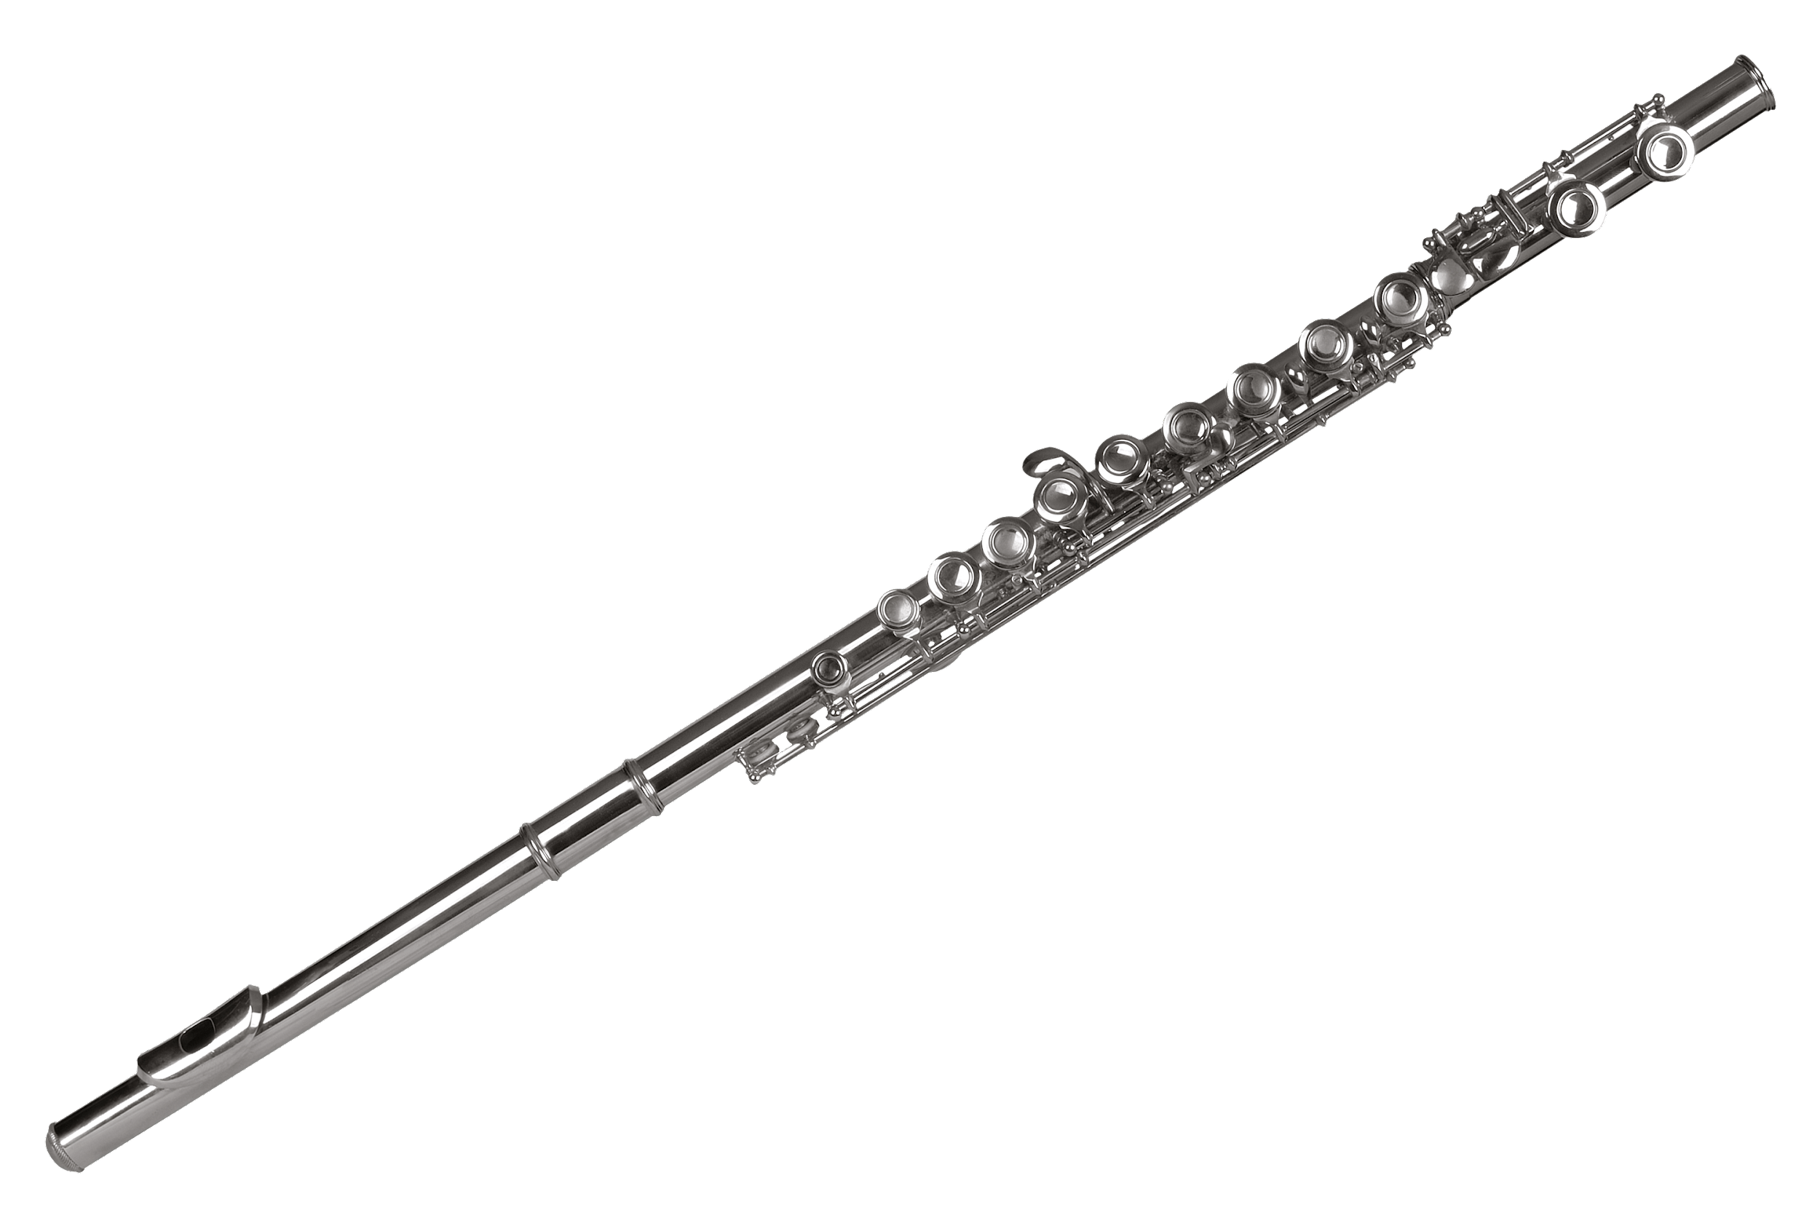
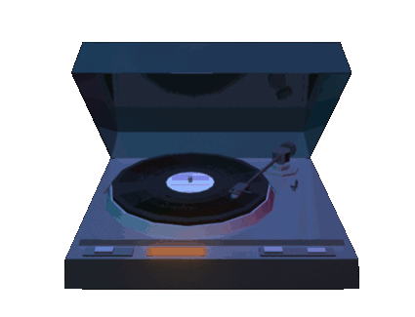
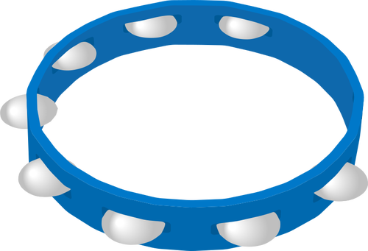
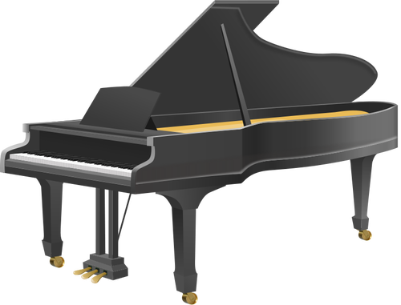
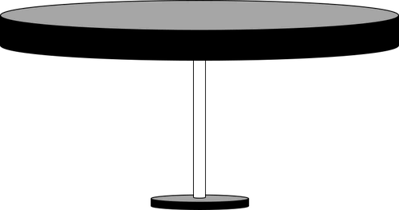
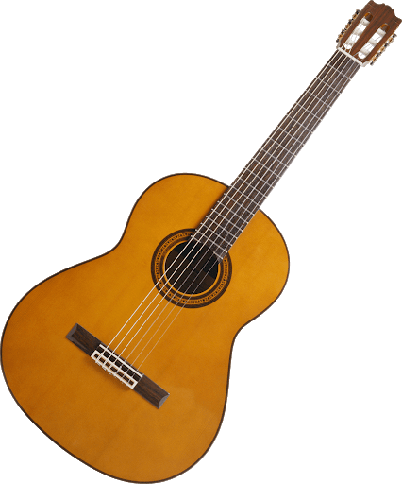

Slide 2
WELCOME TO MRS. PHILLIP’S MUSIC CLASS
Our goal is to provide students with the opportunity to broaden and enrich their musical experiences. The music they perform or study often becomes an integral part of their personal musical repertoire. Creating, performing, and listening to music provides students a unique insight into the form and structure of music and at the same time will help them to develop their creativity and abstract thinking. The role that music will play in students’ lives depends in large measure on the level of skills they achieve in creating, performing and listening to music. Most importantly students will have fun learning and creating music!

Slide 3
Here is a sneak peek of some music we created:
Students had to pick 1 word that described their summer and then play with a boomwhacker that word without saying it.
Here is Mrs. Chang’s class song titled………...
“SUMMER”

Slide 4
GT MUSIC
Our goals is to provide students with the opportunity to broaden and enrich their musical experiences. The course is designed to provide students with advanced skills that will build on their current level of musical achievement.
In our class, students will learn how to compose music using rhythmic and melodic notation. We will then transfer our compositions and input them into notation software. Using our knowledge of composing, we will compose using a multitude of different types of instrumentation and voices.
GT Music meets every Thursday at 7:20 am in the music room

